Slide 1
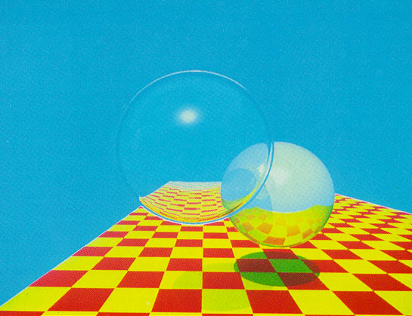
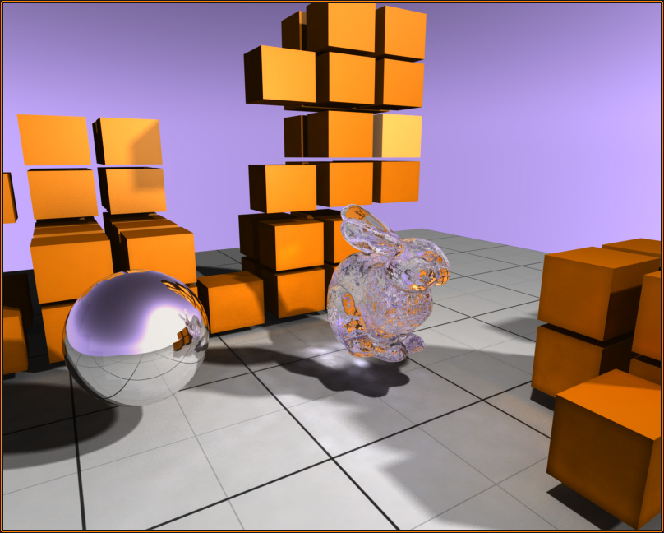
Ray Tracing
Whitted 1980
Rendering and Techniques
http://cg.alexandra.dk/2009/08/10/triers-cuda-ray-tracing-tutorial/

Slide 2
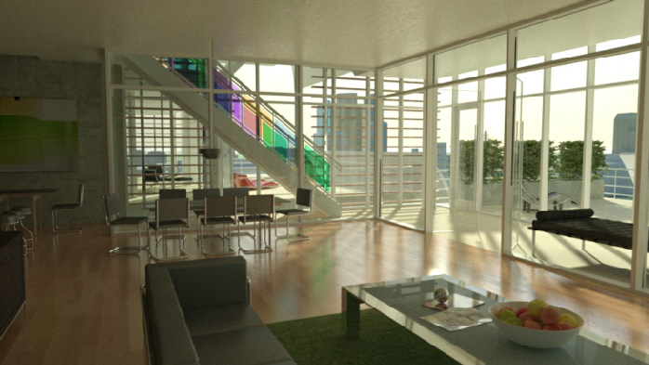
Reading
Rendered with nVidia Iray, which adds physically correct
global illumination on top of ray tracing
See Chapter 7, 15 in the book
http://www.3dfocus.co.uk/wp-content/uploads/2011/03/ray-tracing-d.jpg

Slide 3
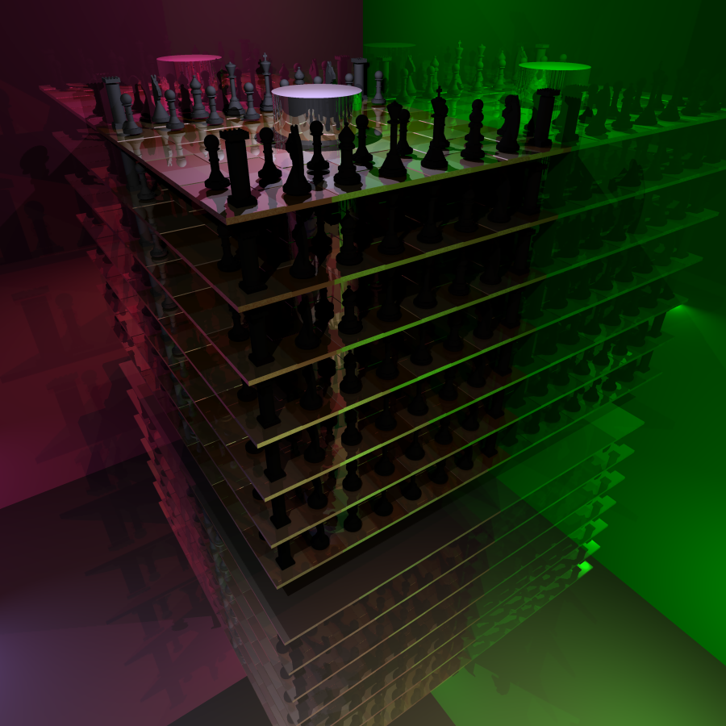
Introduction
What “effects” do you see?
red mirror
“soft” illumination changes
rendered in a matter of seconds with Travis Fischer’s ’09 ray tracer
green mirror
soft shadow?
No, but looks close due to complex scene and multiple light sources

Slide 4
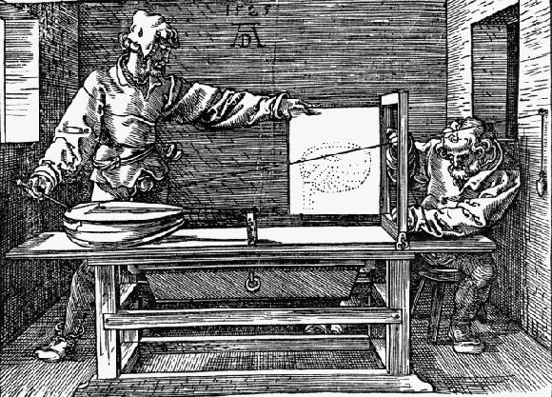
Origins of Ray Tracing
Generalizing from Durer’s wood cut showing perspective projection
Durer: Record string intersection from center of projection(eye) to the object as points on a 2D plane
Points created are perspective projection of 3D object onto 2D plane

Slide 5
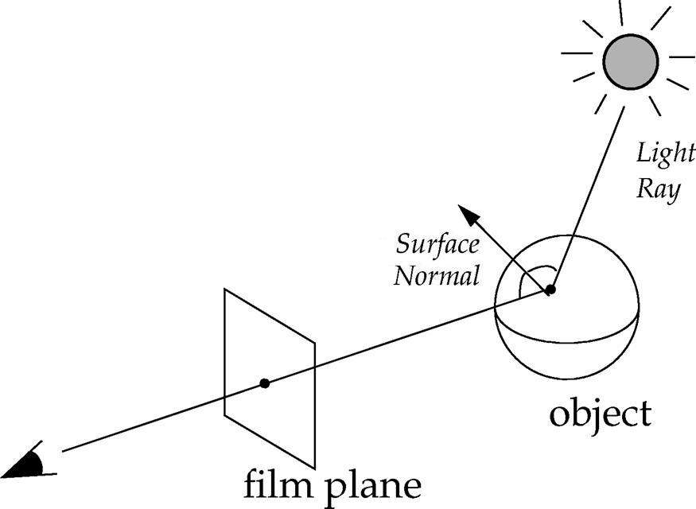
What is a Raytracer?
A raytracer is a finite back-mapping of rays from the camera(eye) through each sample (pixel) to objects in scene, to avoid forward solution for having to sample rays from light sources, not knowing which will be important for the PoV
Each pixel represents either:
a ray intersection with an object in the scene
no intersection
A ray traced scene is a “virtual photo” comprised of many samples on film plane
Instead of one ray, imagine thousands of rays being shot from the eye through different points on film plane
Eye

Slide 6
Ray Tracing Fundamentals
Generate primary ray
shoot rays from eye through sample points on film plane
sample point is typically center of a pixel, but alternatively supersample pixels (recall from Image Processing IV)
Ray-object intersection
Find first object in scene that ray intersects with (if any)
Calculate lighting (i.e. color)
use illumination model to determine direct contribution from light sources (light rays)
specular (a.k.a. reflective) objects recursively generate secondary rays (indirect contribution) that also contribute to the color
Sum of contributions determines color of sample point
No diffuse reflection rays, so limited global illumination
Eye

Slide 7
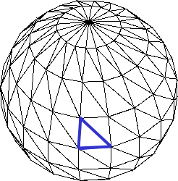
Ray Tracing vs. Triangle Scan Conversion (1/2)
How is ray tracing different from polygon scan conversion? Shapes and Sceneview both use scan conversion to render objects in a scene and follow the same pseudocode:
for each object in scene:
for each triangle in object:
pass vertex geometry and colors to OpenGL,
which renders each triangle (using z-buffer) into framebuffer using OpenGL’s default shaders
(triangle rendered to screen)

Slide 8
Ray Tracing vs. Triangle Scan Conversion (2/2)
Ray tracing uses the following pseudocode:
for each sample in film plane:
determine closest object in scene hit by a ray going through that sample from eye point
set color based on calculation of illumination model for intersected object
Note the distinction: polygonal scan conversion iterates over all VERTICES whereas ray tracing iterates over 2D PIXELS and calculates intersections in a 3D scene
 | E
(ray intersection rendered to screen)

Slide 9
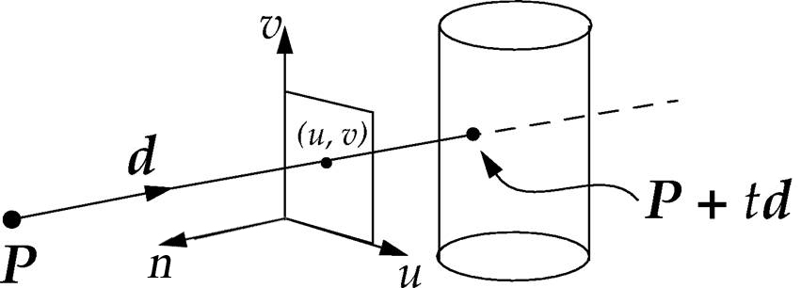
Generate Primary Ray (1/4)
Ray Origin
Let’s look at geometry of the problem in normalized world space with canonical perspective frustum (i.e., do not apply perspective transformation)
Start a ray from “eye point”: P
Shoot ray in some direction d from P toward a point in film plane (a rectangle in the u-v plane in the camera’s uvw space) whose color we want to know
Points along ray have form P + td where
P is ray’s base point: camera’s eye
d is unit vector direction of ray
t is a non-negative real number
“Eye point” is center of projection in perspective view volume (view frustum)
Don’t use de-perspectivizing (unhinging) step in order to avoid dealing with inverse of non-affine perspective transformation later on – stay tuned
w

Slide 10
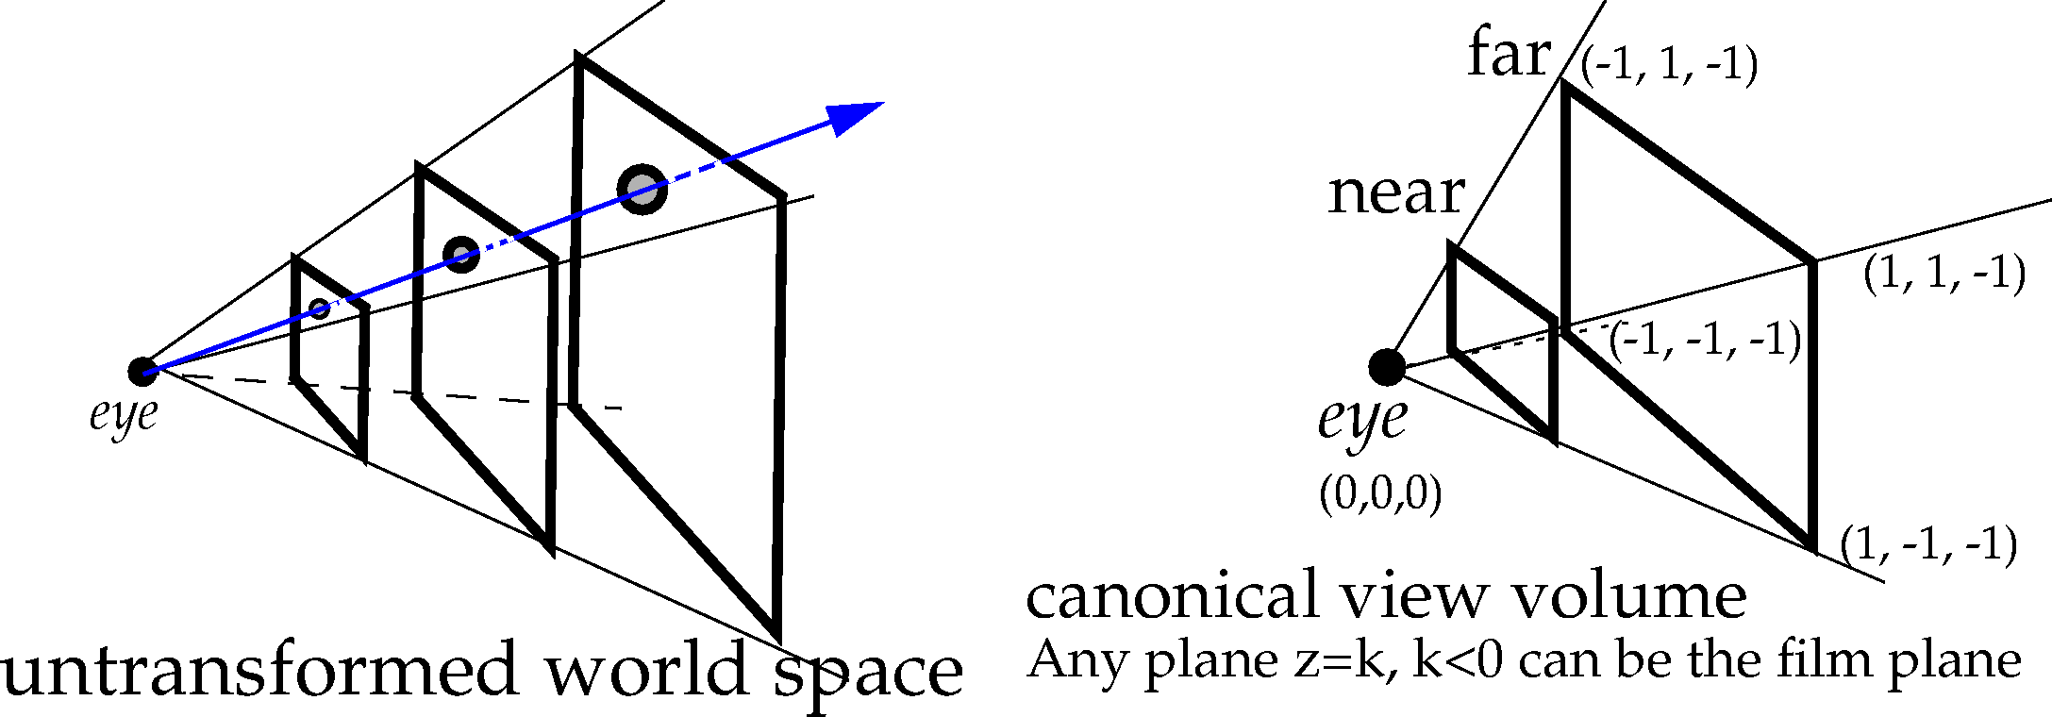
Generate Primary Ray (2/4)
Ray Direction
Start with 2D screen-space point (pixel)
In order to create a ray from eye point through film plane, 2D screen-space point must be converted into a 3D point on the film plane
Note that ray generated will be intersecting objects in normalized world space coordinate system
Any plane orthogonal to look vector is a convenient film plane (plane z = k in canonical frustum)
Choose a film plane and then create a function that maps screen space points onto it
what’s a good plane to use? Try the far clipping plane ☺ (z = - 1)
to convert, we have to scale integer screen-space coordinates into real values between -1 and 1
canonical frustum
Any plane z = k, -1<= k < 0 can be the film plane

Slide 11
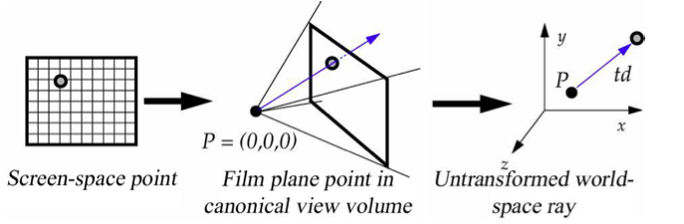
Generate Primary Ray (3/4)
Ray Direction (continued)
Once we have a 3D point on the film plane, need to transform to world space
make a direction vector from eye (at center of projection) to 3D point on film plane
need this vector to be in world-space in order to intersect with original object in world coordinate system
illumination model requires intersection point to be in world-space
Normalizing transformation maps world-space points to points in the canonical view volume
translate to the origin; orient so Look points down –Z, Up along Y; scale x and y to adjust viewing angles to 45˚, scale z: [-1, 0]; x, y: [-1, 1]
How do we transform a point from the canonical view volume back to untransformed world space?
apply the inverse of the normalizing transformation: Viewing Transformation
Note that this is not the same as the viewing transform you hear about in OpenGL (e.g., Modelview matrix)

Slide 12
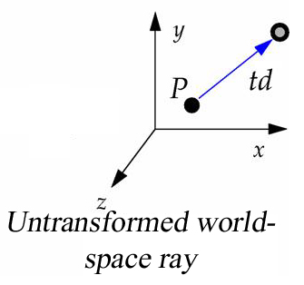
Generate Primary Ray (4/4)
Summary
Start the ray at center of projection (“eye point”)
Map 2D integer screen-space point onto 3D film plane in normalized frustum
scale x, y to fit between -1 and 1
set z to -1 so points lie on the far clip plane
Transform 3D film plane point (mapped pixel) to an untransformed world-space point
need to undo normalizing transformation (i.e., viewing transformation)
Construct the direction vector
a point minus a point is a vector
direction = (world-space point (mapped pixel)) – (eye point (in world space))

Slide 13
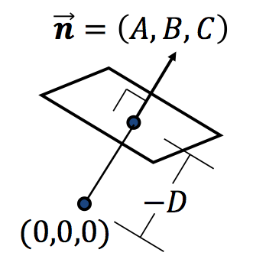
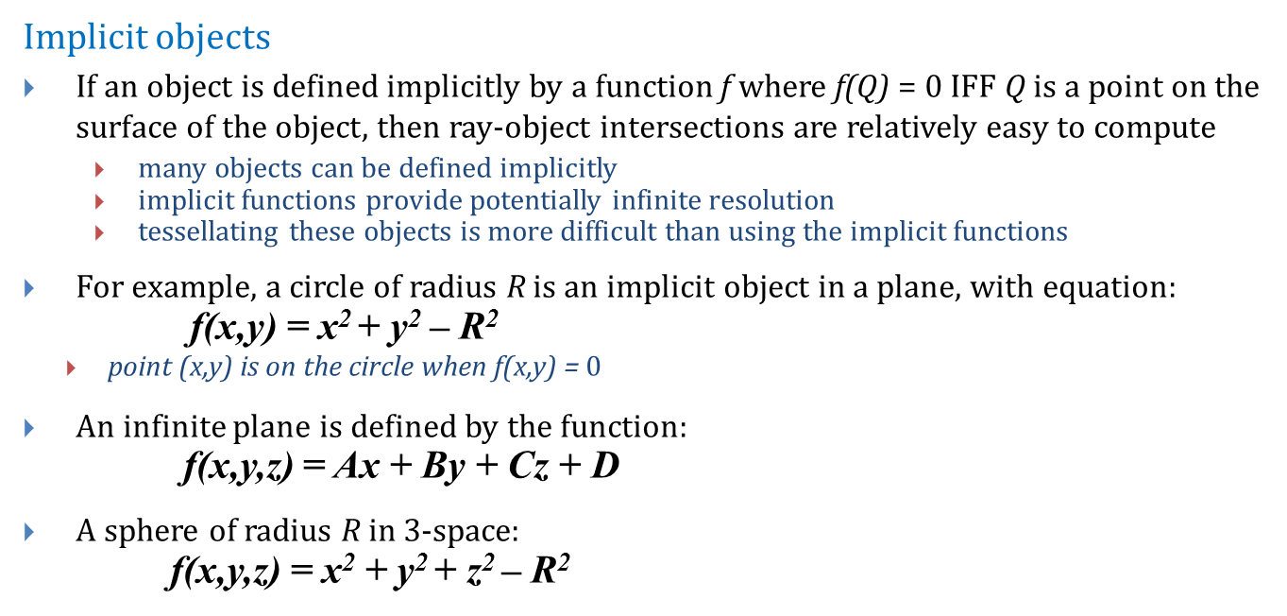
Ray-Object Intersection (1/5)
Implicit objects
If an object is defined implicitly by a function f where f(Q) = $0$ IFF Q is a point on the surface of the object, then ray-object intersections are relatively easy to compute
many objects can be defined implicitly
implicit functions provide potentially infinite resolution
tessellating these objects is more difficult than using the implicit functions
For example, a circle of radius R is an implicit object in a plane, with equation:
f(x,y) = x² + y² – R²
point (x,y) is on the circle when f(x,y) = $0$
An infinite plane is defined by the function:
f(x,y,z) = Ax + By + Cz + D
A sphere of radius R in 3-space:
f(x,y,z) = x² + y² + z² – R²

Slide 14
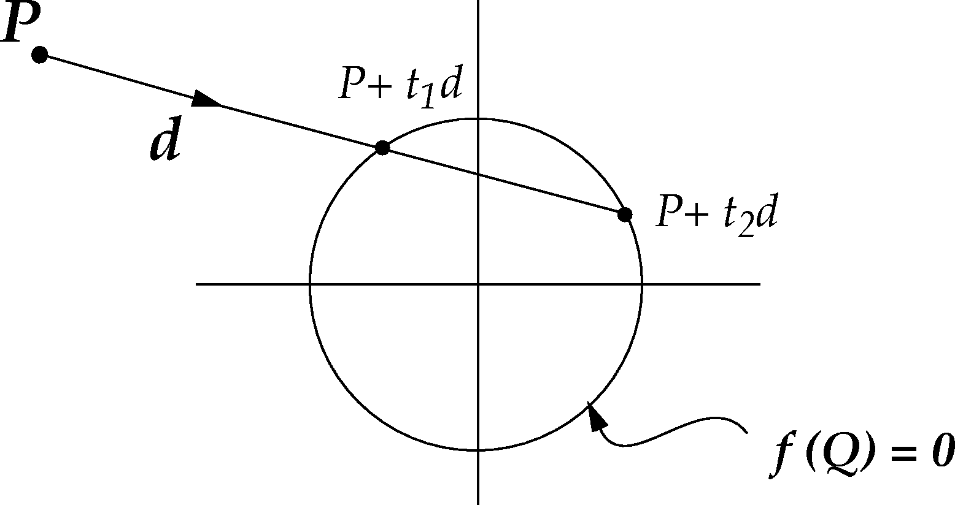
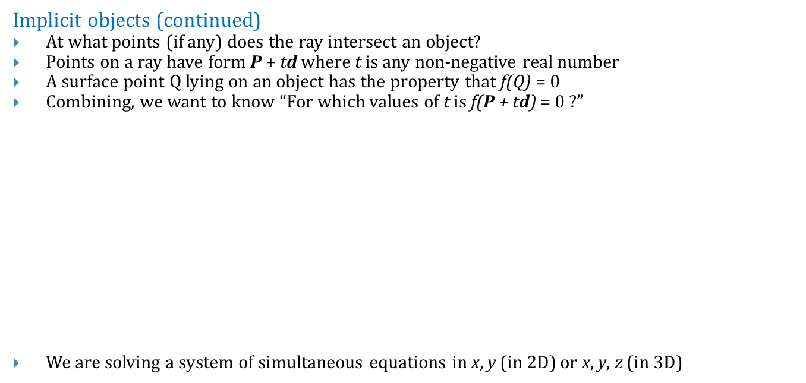
Ray-Object Intersection (2/5)
Implicit objects (continued)
At what points (if any) does the ray intersect an object?
Points on a ray have form P + td where t is any non-negative real number
A surface point Q lying on an object has the property that f(Q) = $0$
Combining, we want to know “For which values of t is f(P + td) = $0$ ?”
We are solving a system of simultaneous equations in x, y (in 2D) or x, y, z (in 3D)

Slide 15
An Explicit Example (1/3)
2D ray-circle intersection example
Consider the eye-point P = (-3, 1), the direction vector d = (.8, -.6) and the unit circle: f(x,y) = x² + y² – R²
A typical point of the ray is: Q = P + td = (-3,1) + t(.8,-.6) = (-3 + .8t,1 - .6t)
Plugging this into the equation of the circle: f(Q) = f(-3 + .8t,1 - .6t) = (-3+.8t)² + (1-.6t)² - 1
Expanding, we get: 9 – 4.8t + .64t² + 1 – 1.2t + .36t² - 1
Setting this equal to zero, we get: t² – 6t + 9 = 0

Slide 16
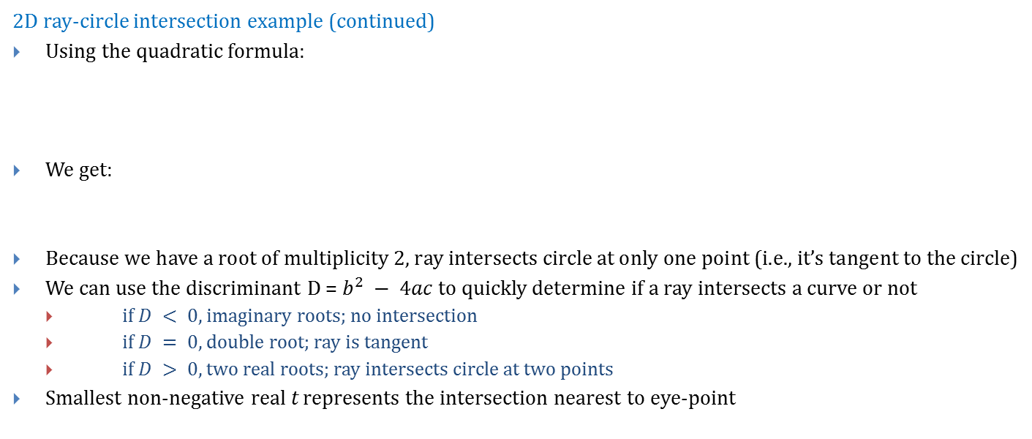
An Explicit Example (2/3)
2D ray-circle intersection example (continued)
Using the quadratic formula:
We get:
Because we have a root of multiplicity 2, ray intersects circle at only one point (i.e., it’s tangent to the circle)
We can use the discriminant D = $b^{2} − 4ac$to quickly determine if a ray intersects a curve or not
if $D < 0$, imaginary roots; no intersection
if $D = 0$, double root; ray is tangent
if $D > 0$, two real roots; ray intersects circle at two points
Smallest non-negative real t represents the intersection nearest to eye-point

Slide 17
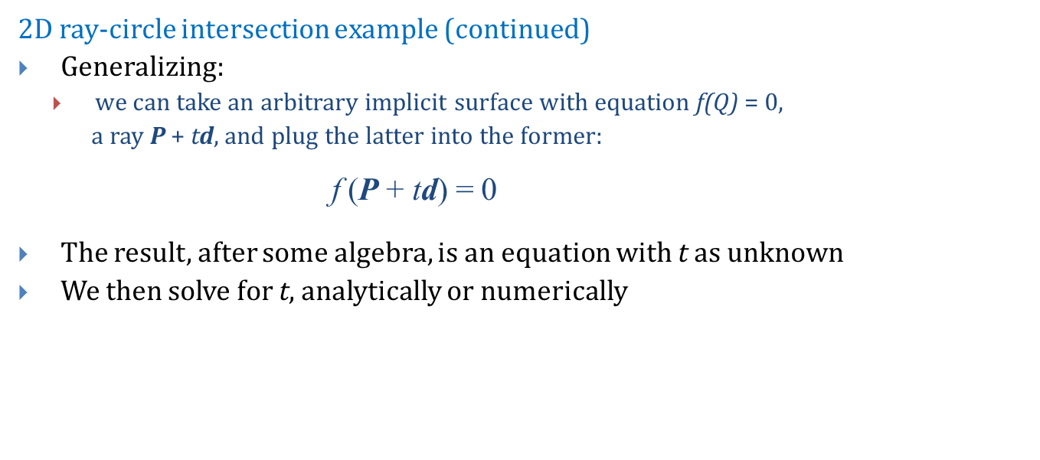
An Explicit Example (3/3)
2D ray-circle intersection example (continued)
Generalizing:
we can take an arbitrary implicit surface with equation f(Q) = $0$,
a ray P + td, and plug the latter into the former:
f (P + td) = 0
The result, after some algebra, is an equation with t as unknown
We then solve for t, analytically or numerically
w

Slide 18
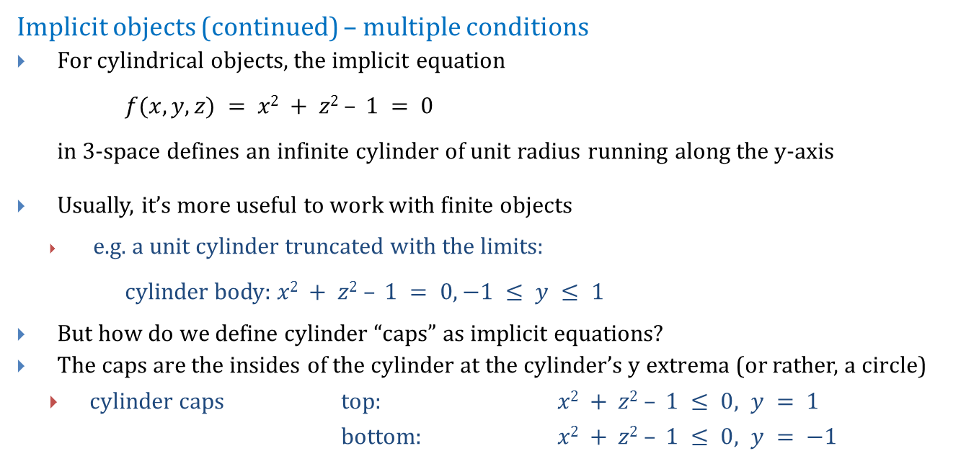
Ray-Object Intersection (3/5)
Implicit objects (continued) – multiple conditions
For cylindrical objects, the implicit equation
$f(x,y,z) = x2 + z2 – 1 = 0$
in 3-space defines an infinite cylinder of unit radius running along the y-axis
Usually, it’s more useful to work with finite objects
e.g. a unit cylinder truncated with the limits:
cylinder body: $x2 + z2 – 1 = 0, −1 ≤ y ≤ 1$
But how do we define cylinder “caps” as implicit equations?
The caps are the insides of the cylinder at the cylinder’s y extrema (or rather, a circle)
cylinder caps top: $x2 + z2 – 1 ≤ 0, y = 1$
bottom: $x2 + z2 – 1 ≤ 0, y = −1$

Slide 19
Ray-Object Intersection (4/5)
Implicit objects (continued) – cylinder pseudocode
Solve in a case-by-case approach
Ray_inter_finite_cylinder(P,d):
t1,t2 = ray_inter_infinite_cylinder(P,d) // Check for intersection with infinite cylinder
compute P + t1*d, P + t2*d
if y > 1 or y < -1 for t1 or t2: toss it // If intersection, is it between cylinder caps?
t3 = ray_inter_plane(plane y = 1) // Check for an intersection with the top cap
Compute P + t3*d
if x² + z² > 1: toss out t3 // If it intersects, is it within cap circle?
t4 = ray_inter_plane(plane y = -1) // Check intersection with bottom cap
Compute P + t4*d
if x² + z² > 1: toss out t4 // If it intersects, is it within cap circle?
Of all the remaining t’s (t1 – t4), select the smallest non-negative one.
If none remain, ray does not intersect cylinder

Slide 20
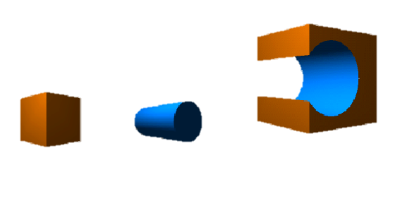
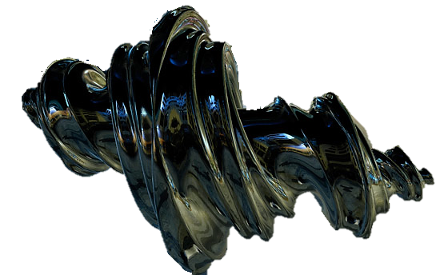
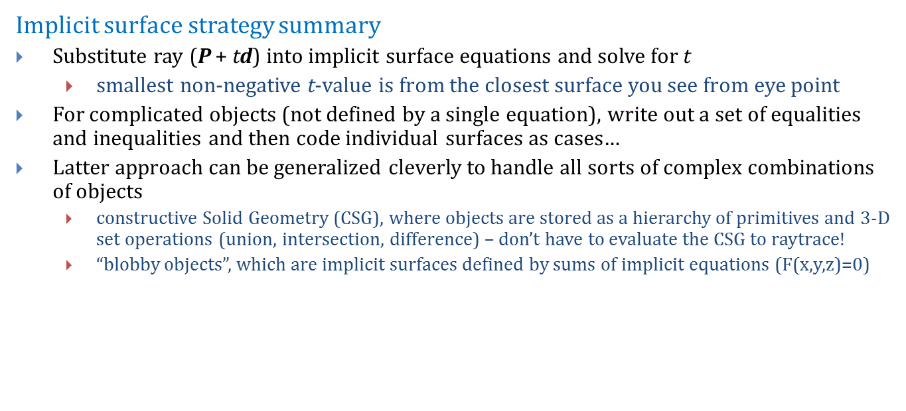
Ray-Object Intersection (5/5)
Implicit surface strategy summary
Substitute ray (P + td) into implicit surface equations and solve for t
smallest non-negative t-value is from the closest surface you see from eye point
For complicated objects (not defined by a single equation), write out a set of equalities and inequalities and then code individual surfaces as cases…
Latter approach can be generalized cleverly to handle all sorts of complex combinations of objects
constructive Solid Geometry (CSG), where objects are stored as a hierarchy of primitives and 3-D set operations (union, intersection, difference) – don’t have to evaluate the CSG to raytrace!
“blobby objects”, which are implicit surfaces defined by sums of implicit equations (F(x,y,z)=$0$)
Cool Blob!
CSG!

Slide 21
World Space Intersection
In order to compute illumination correctly, objects need to be intersected in world space. Thus need an analytical description of each object in world space
Example: unit sphere translated to (3, 4, 5) after it was scaled by 2 in the x-direction has equation
Can take ray P+td and plug it into the equation, solving for t
f (P + td ) = 0
But intersecting with an arbitrarily transformed object is difficult
intersecting with an untransformed shape, on the other hand, is much easier
can take advantage of transformations to change intersection problem from world space (arbitrarily transformed shape) to object space (untransformed shape)

Slide 22
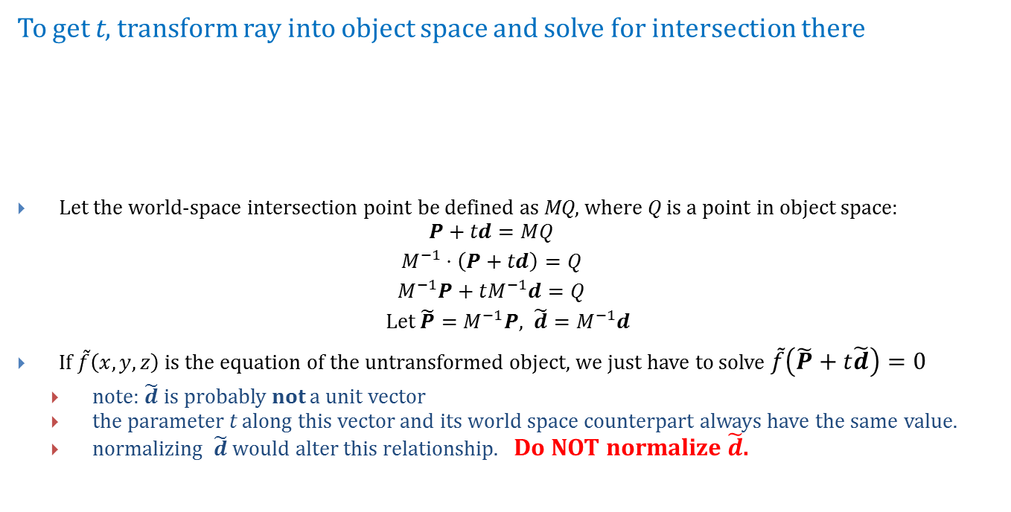
Object Space Intersection
To get t, transform ray into object space and solve for intersection there
Let the world-space intersection point be defined as MQ, where Q is a point in object space:
$$P+td=MQ$$
$$M^{−1}⋅\left(P+td\right)=Q$$
$$M^{−1}P+tM^{−1}d=Q$$
Let $\tilde{P}=M^{−1}P, \tilde{d}=M^{−1}d$
If $\tilde{f}\left(x,y,z\right)$ is the equation of the untransformed object, we just have to solve $\tilde{f}\left(\tilde{P}+t\tilde{d}\right)=0$
note: $\tilde{d}$ is probably not a unit vector
the parameter t along this vector and its world space counterpart always have the same value.
normalizing $\tilde{d}$would alter this relationship. Do NOT normalize $\tilde{d}$.
MQ
Q

Slide 23
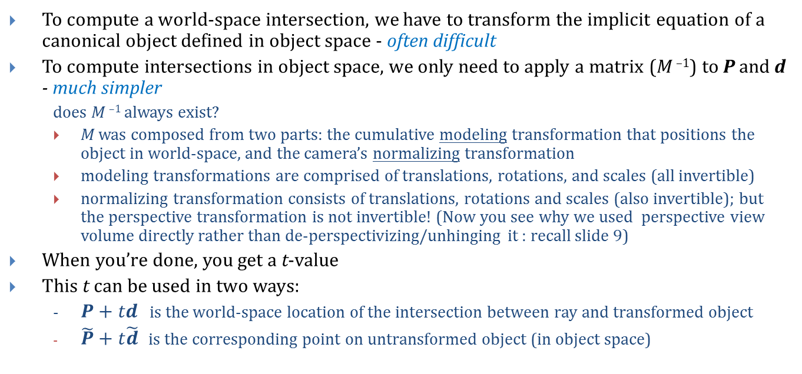
World Space vs. Object Space
To compute a world-space intersection, we have to transform the implicit equation of a canonical object defined in object space - often difficult
To compute intersections in object space, we only need to apply a matrix (M ^{–1}) to P and d - much simpler
does M ^{–1} always exist?
M was composed from two parts: the cumulative modeling transformation that positions the object in world-space, and the camera’s normalizing transformation
modeling transformations are comprised of translations, rotations, and scales (all invertible)
normalizing transformation consists of translations, rotations and scales (also invertible); but the perspective transformation is not invertible! (Now you see why we used perspective view volume directly rather than de-perspectivizing/unhinging it : recall slide 9)
When you’re done, you get a t-value
This t can be used in two ways:
- $P+td$ is the world-space location of the intersection between ray and transformed object
$\tilde{P}+t\tilde{d}$ is the corresponding point on untransformed object (in object space)

Slide 24
Normal Vectors at Intersection Points (1/4)
Normal vector to implicit surfaces
For illumination, you need to know the normal at the point of intersection in world space
Instead, start by solving for point of intersection in object's own space and compute th e normal there. Then transform this object space normal to world space
If a surface bounds a solid whose interior is given by
Then we can find a normal vector at point (x, y, z) via gradient at that point:
Recall that the gradient is a vector with three components, the partial derivatives:

Slide 25
Normal Vectors at Intersection Points (2/4)
Sphere normal vector example
For the sphere, the equation is:
f (x,y,z) = x² + y² + z² – 1
The partial derivatives are
So the gradient is
Remember to normalize n before using in dot products!
In some degenerate cases, gradient may be zero and this method fails…use nearby gradient as a cheap hack

Slide 26
Normal Vectors at Intersection Points (3/4)
Transforming back to world space
We now have an object-space normal vector
We need a world-space normal vector for the illumination equation
To transform an object to world coordinates, we just multiplied its vertices by M, the object’s CTM
Can we do the same for the normal vector?
answer: NO
Example: say M scales in x by .5 and y by 2
Mn_{object}
Normal must be perpendicular
Wrong!
n_{object}

Slide 27
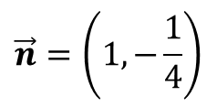
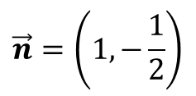
Normal Vectors at Intersection Points (4/4)
Why doesn’t multiplying the normal by M work?
For translation and rotation, which are rigid body transformations, it actually does work fine
Scaling, however, distorts the normal in exactly the opposite sense of the scale applied to the surface
scaling y by a factor of 2 causes the normal to scale by .5:
We’ll see this algebraically in the next slides
$$\vec{n}=\left(1,−\frac{1}{4}\right)$$
$$\vec{n}=\left(1,−\frac{1}{2}\right)$$

Slide 28
Transforming Normals (1/4)
Object-space to world-space
As an example, let’s look at the polygonal case
Let’s compute the relationship between object-space normal n_{obj} to polygon H and world-space normal n_{world} to transformed version of H, called MH
For any vector v in world space that lies in the polygon (e.g., one of its edge vectors), the normal is perpendicular to v:
But v_{world} is just a transformed version of some vector in object space, v_{obj}. So we could write:
Recall that since vectors have no position, they are unaffected by translations (thus they have w = 0)
so to make things easier, we only need to consider:
M₃ = upper left 3 x 3 of M
n_{world} • M₃ v_{obj} = 0
(rotation/scale component)

Slide 29
Transforming Normals (2/4)
Object-space to world-space (continued)
So we want a vector n_{world} such that for any v_{obj} in the plane of the polygon:
We will show on next slide that this equation can be rewritten as:
We also already have:
Therefore:
Left-multiplying by (M₃^{t})⁻¹,

Slide 30
Transforming Normals (3/4)
Object-space to world-space (continued)
So how did we rewrite this:
As this:
Recall that if we think of vector as n x 1 matrices, then switching notation:
Rewriting our original formula, yielding:
Writing M = M ^{t t}, we get:
Recalling that (AB)^{t} = B^{t}A^{t}, we can write:
Switching back to dot product notation, our result:
n_{world} • M₃v_{obj} = 0
(M₃^{t} n_{world} ) • v_{obj} = 0
a • b = a^{t} b
n^{t}_{world} M₃v_{obj} = 0
n^{t}_{world} M₃^{tt} v_{obj} = 0
(M₃^{t} n_{world} )^{t} v_{obj} = 0
(M₃^{t} n_{world} ) • v_{obj} = 0

Slide 31
Transforming Normals (4/4)
Applying inverse-transpose of M to normals
So we ended up with:
“Invert” and “transpose” can be swapped, to get our final form:
Why do we do this? It’s easier!
instead of inverting composite matrix, accumulate composite of inverses which are easy to take for each individual transformation
A hand-waving interpretation of (M₃⁻¹)^{t}
M₃ is composition of rotations and scales, R and S (why no translates?). Therefore
so we’re applying transformed (inverted, transposed) versions of each individual matrix in original order
for rotation matrix, transformed version equal to original rotation, i.e., normal rotates with object
(R⁻¹)^{t} = R; inverse reverses rotation, and transpose reverses it back
for scale matrix, inverse inverts scale, while transpose does nothing:
(S(x,y,z)⁻¹)^{t} = S(x,y,z)⁻¹=S(1/x,1/y,1/z)

Slide 32
Summary – putting it all together
Simple, non-recursive raytracer
P = eyePt
for each sample of image:
Compute d
for each object:
Intersect ray P+td with object
Select object with smallest non-negative t-value (visible object)
For this object, find object space intersection point
Compute normal at that point
Transform normal to world space
Use world space normal for lighting computations

Slide 33
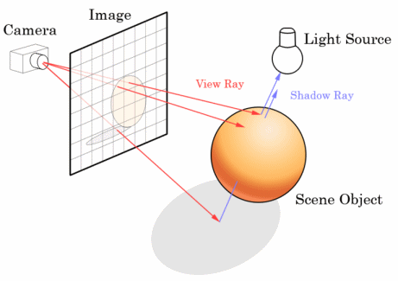
Shadows
Each light in the scene contributes to the color and intensity of a surface element…
If and only if light source reaches the object!
could be occluded/obstructed by other objects in scene
could be self-occluding
Construct a ray from the surface intersection to each light
Check if light is first object intersected
if first object intersected is the light, count light’s full contribution
if first object intersected is not the light, do not count (ignore) light’s contribution
this method generates hard shadows; soft shadows are harder to compute (must sample)
What about transparent or specular (reflective) objects? Such lighting contributions are the beginning of global illumination => need recursive ray tracing
numLights
Σ
objectIntensity_{λ} = ambient + attenuation ∙ lightIntensity_{λ} ∙ [diffuse + specular]
light = 1

Slide 34
Recursive Ray Tracing Example
Whitted 1980
Ray traced image with recursive ray tracing: transparency and refractions

Slide 35
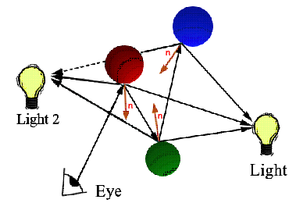
Recursive Ray Tracing (1/4)
Simulating global lighting effects (Whitted, 1979)
By recursively casting new rays into the scene, we can look for more information
Start from point of intersection with object
We’d like to send rays in all directions , but that’s too hard/computationally taxing
Instead, just send rays in directions likely to contribute most:
toward lights (blockers to lights create shadows for those lights)
specular bounce off other objects to capture specular inter-object reflections
use ambient hack to capture diffuse inter-object reflection
through object (transparency)
Shadow Ray
Recursive Rays
Primary Ray

Slide 36
Recursive Ray Tracing (2/4)
Trace “secondary” rays at intersections:
light: trace a ray to each light source. If light source is blocked by opaque an object, it does not contribute to lighting
specular reflection: trace reflection ray (i.e. about normal vector at surface intersection)
refractive transmission/transparency: trace refraction ray (following Snell’s law)
recursively spawn new light, reflection, and refraction rays at each intersection until contribution negligible or some max recursion depth is reached
Limitations
recursive inter-object reflection is strictly specular
diffuse inter-object reflection is handled differently
Oldies-but-goodies
Ray Tracing Silent Film, A Long Ray’s Journey into Light

Slide 37
Recursive Ray Tracing (3/4)
Your new lighting equation (Phong lighting + specular reflect + transmission):
I is the total color at a given point (λ subscript for each r,g,b)
Its presence in the transmitted and reflected terms implies recursion
L is the light intensity; L_{P} is the intensity of a point light source
k is the attenuation coefficient for the object material (ambient, diffuse, specular, etc.)
O is the object color
f_{att} is the attenuation function for distance
n is the normal vector at the object surface
l is the vector to the light
r is the reflected light vector
v is the vector the eye point (view vector)
n is the specular exponent
note: intensity from recursive rays calculated with the same lighting equation at the intersection point
light sources contribute specular and diffuse lighting
Note: single rays of light do not attenuate with distance; purpose of f_{att} is to simulate diminishing intensity per unit area as function of distance for point lights

Slide 38
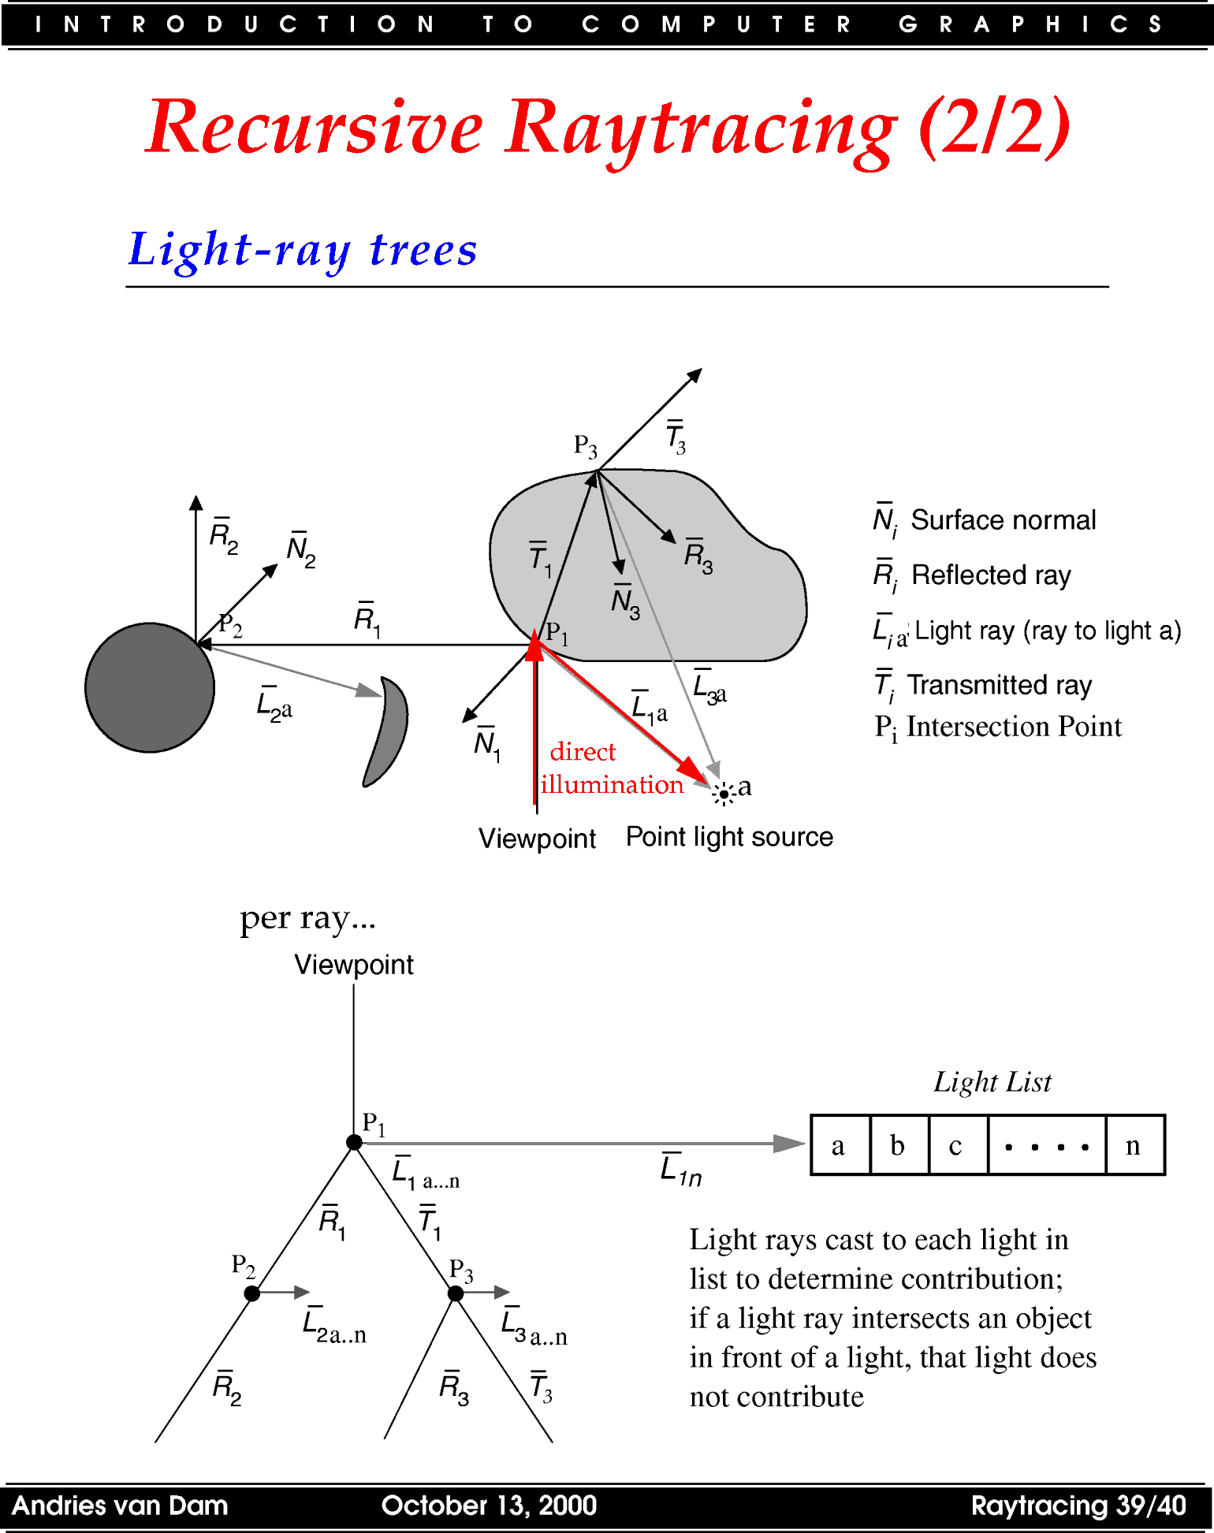
Recursive Ray Tracing (4/4)
Light-ray trees
indirect illumination
per ray:

Slide 39
Transparent Surfaces (1/2)
Non-refractive transparency
For a partially transparent polygon
I_{λ1}
polygon 1
I_{λ2}
polygon 2

Slide 40
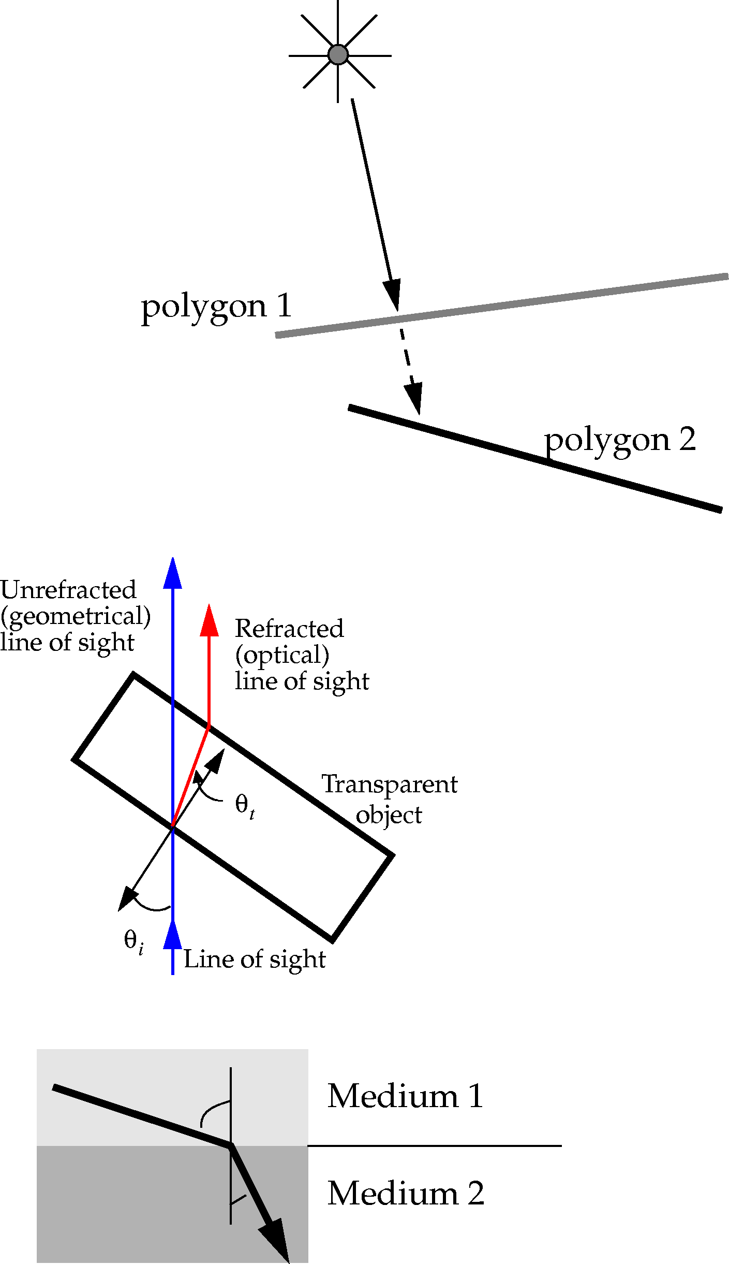
Transparent Surfaces (2/2)
Refractive transparency
We model the way light bends at interfaces with Snell’s Law
r
medium 1
medium 2

Slide 41
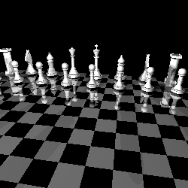
Choosing Samples (1/2)
Sampling
In both the examples and in your assignments we sample once per pixel. This generates images similar to this:
We have a clear case of the jaggies
Can we do better?

Slide 42
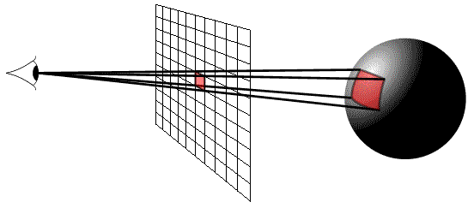
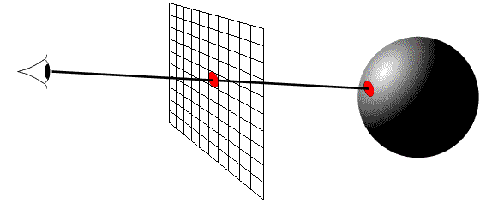
Choosing Samples (2/2)
In the simplest case, sample points are chosen at pixel centers
For better results, supersamples can be chosen (called supersampling)
e.g., at corners of pixel as well as at center
Even better techniques do adaptive sampling: increase sample density in areas of rapid change (in geometry or lighting)
With stochastic sampling, samples are taken probabilistically (recall Image Processing IV slides)
Actually converges on “correct” answer faster than regularly spaced sampling
For fast results, we can subsample: fewer samples than pixels
take as many samples as time permits
beam tracing: track a bundle of neighboring rays together
How do we convert samples to pixels? Filter to get weighted average of all the samples per pixel!
vs.
Instead of sampling one point, sample within a region to create a better approximation

Slide 43

Supersampling example
With Supersampling
Without Supersamping

Slide 44
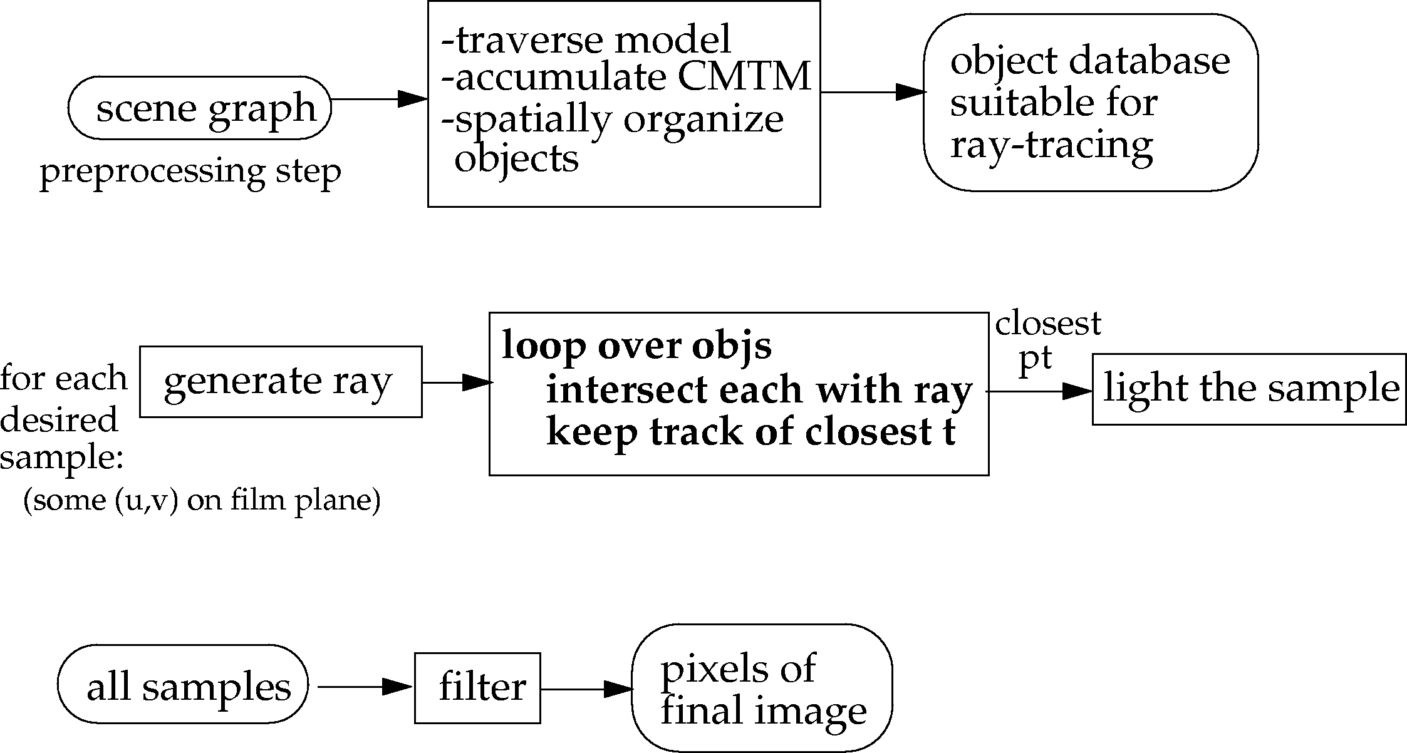

Ray Tracing Pipeline
Raytracer produces visible samples from model
samples convolved with filter to form pixel image
Additional pre-processing
pre-process database to speed up per-sample calculations
For example: organize by spatial partitioning via bins and/or bounding boxes (k-d trees, octrees, etc)
smallest t
generate secondary rays

Slide 45
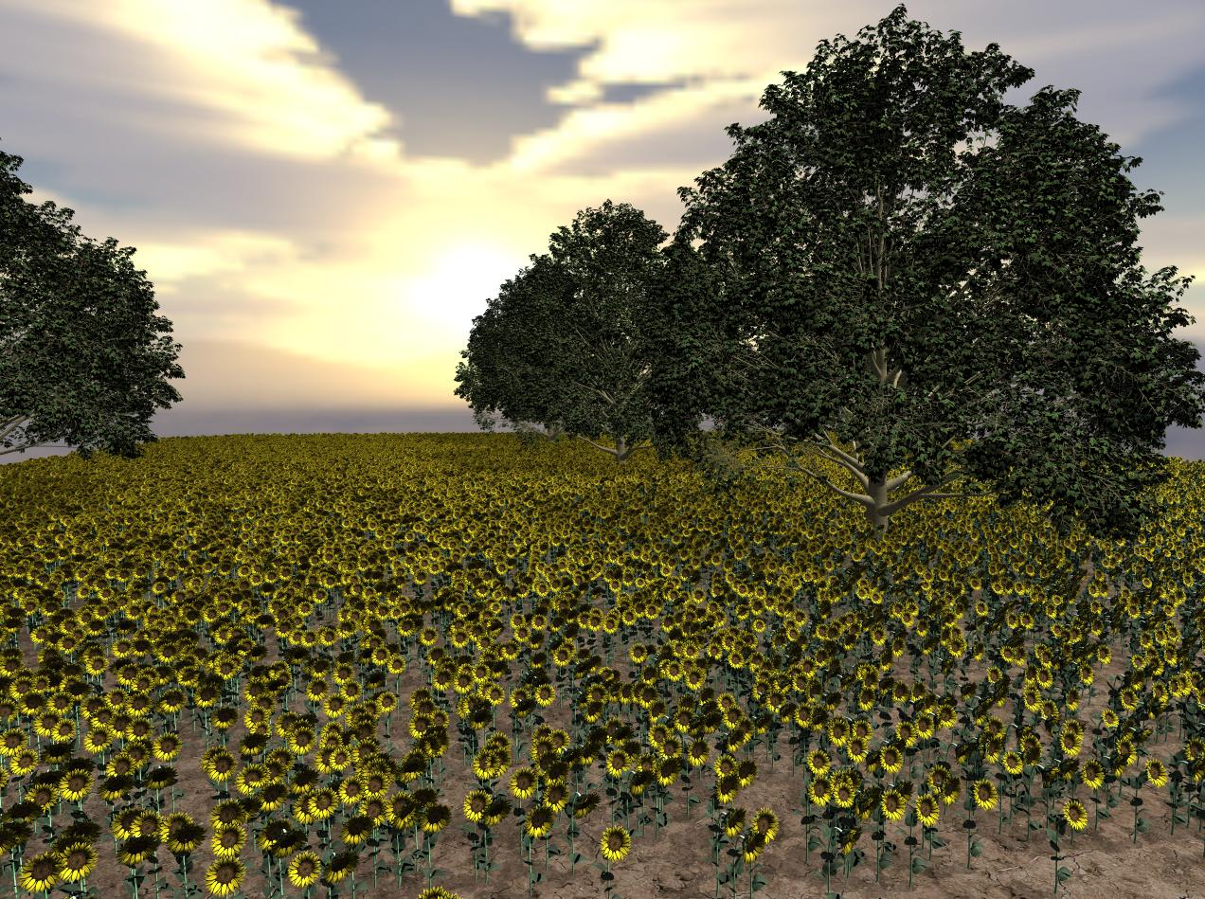
Real-time Ray Tracing (1/2)
Traditionally, ray tracing computationally impossible to do in real-time
“embarrassing” parallelism due to independence of each ray
hard to make hardware optimized for ray tracing:
large amount of floating point calculations
complex control flow structure
complex memory access for scene data
One solution: software-based, highly optimized raytracer using cluster with multiple CPUs
Prior to ubiquitous GPU-based methods, ray tracing on CPU clusters to take advantage of parallelism
hard to have widespread adoption because of size and cost
Can speed up with more cores per CPU
Large CPU render farms still exist, but generally used for CGI
Weta Digital (Avatar), ILM, etc.
OpenRT rendering of five maple trees and 28,000 sunflowers (35,000 triangles) on 48 CPUs

Slide 46
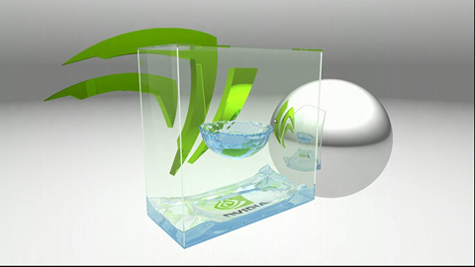
Real-time Ray Tracing (2/2)
Modern solution: Use GPU’s to speed up ray tracing
On the cutting edge, Nvidia Kepler architecture capable of real time ray tracing
Demo at GTC 2012: http://www.youtube.com/watch?v=h5mRRElXy-w
(Skip ahead to 2:05 for actual ray tracing)
Scene ray traced in real time using Nvidia Kepler

Slide 47

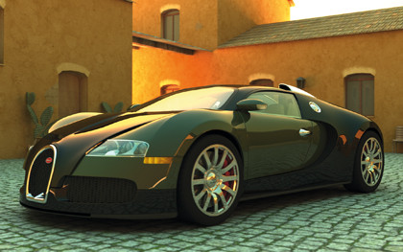
GPU Ray Tracing
nVidia OptiX framework
Built on top of existing CUDA parallel programming model
You can run the demos and download the SDK yourself!
http://developer.nvidia.com/optix
You can also use GLSL shaders (like the ones you’ve been writing in lab) to implement a ray tracer
Weta Digital (Avatar, LOTR, X-Men) moving to GPU clusters for better efficiency
OptiX SDK samples

Slide 48


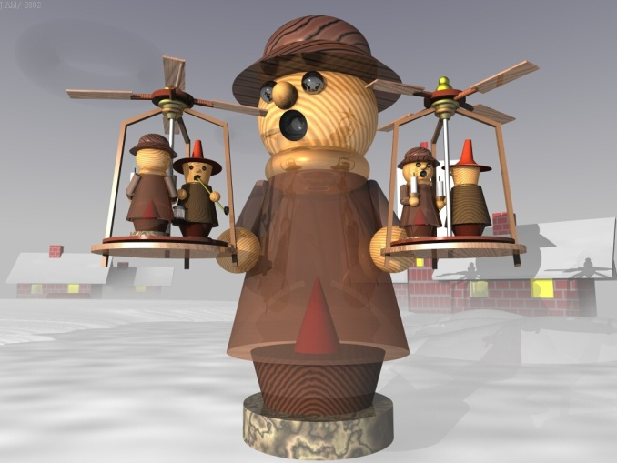
POV-Ray: Pretty Pictures
Free Advanced Raytracer
Full-featured raytracer available online: povray.org
Obligatory pretty pictures (see irtc.org):
Image credits: Jochen Diehl (top), Juergen Ahl (bottom right)

